Slide 1
Optimus Predictive Data Modeling Report: May 2014 General Election Turnout
Using Logistic Regression model

Slide 2
Problem Summary
Understanding and predicting voter turnout is critical for effective campaign strategy. The objective of this analysis is to build a reliable model that identifies which registered voters are likely to vote, enabling targeted field operations.

Slide 3
Data Overview
Dataset: Nevada 2014 Voter File
Total Records: 1703 voters
Features Considered:
Age
Vote history (previous participation)
Registration party
Gender
Zip code and county
Registration date
Ethnicity and other demographic signals

Slide 4
Model Accuracy
Model Used: Logistic Regression
Target Variable: voted_general_2014 (0 = No, 1 = Yes)
Classification Report:
Accuracy: 1.00
Precision / Recall / F1-Score: Perfect across both classes
Validation: 70/30 train-test split, stratified sampling

Slide 5
Key Insights
Age and vote history are the strongest predictors of turnout. Older voters and those who have previously voted are significantly more likely to vote again.
Party affiliation and registration recency show moderate influence.
Gender and zip code contribute minor predictive value.

Slide 6
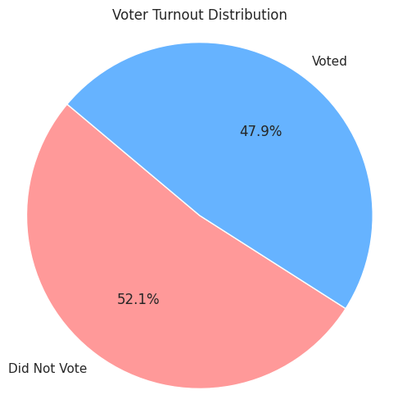
Analysis

